Slide 1
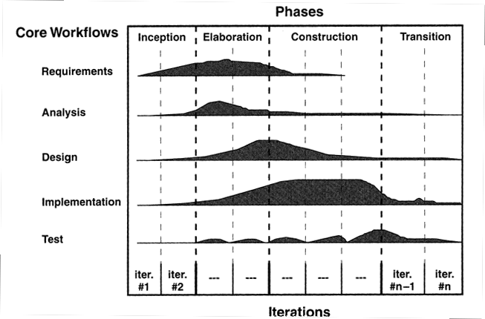
Core workflows
Notes:
Every phase has an iteration

Slide 2
Extreme Programming
Plan
Small releases
Shared metaphor
Simple design
Continuous testing
Refactoring
Pair programming
Collective ownership
Continuous integration
On-site customer
40-hour week
Open workspace
Coding standards

Slide 3
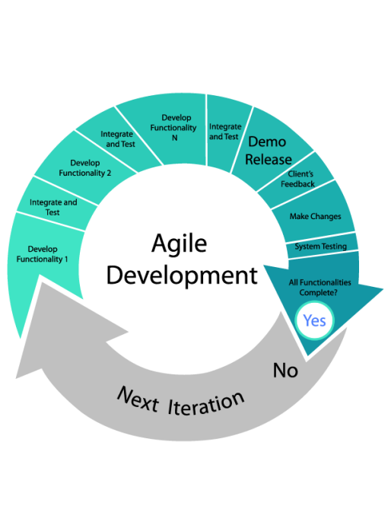
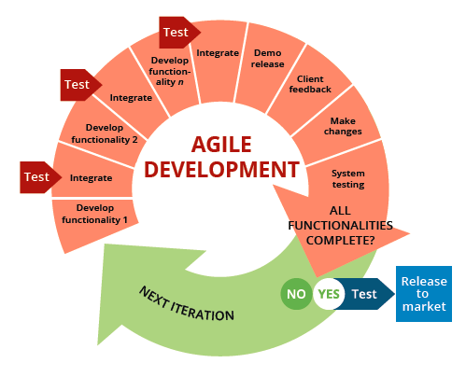
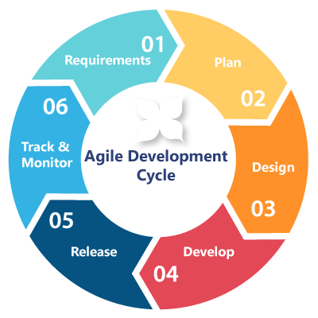
Agile Software Development

Slide 4
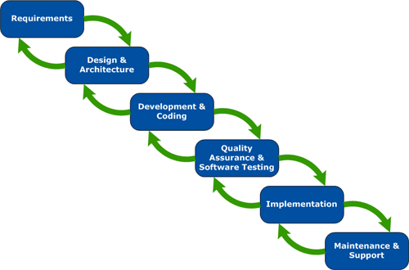
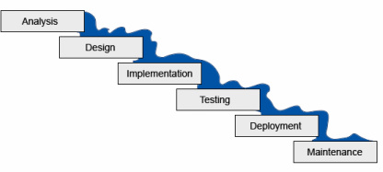
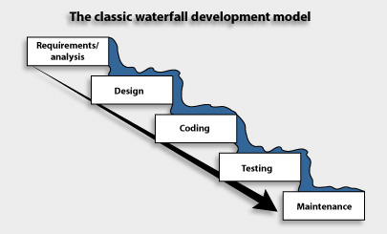
Waterfall Software Development

Slide 5
Waterfall model
Requirements Definition
System and
software design
Implementation and unit testing
Integration and system testing
Operation and maintenance

Slide 6
Spiral model of the software process
Determine objectives
alternatives and constraints
Evaluate alternatives
Identify and resolve risks
Risk
analysis
Risk
analysis
Risk
analysis
Prototype 3
Prototype 2
Operational
Prototype
Risk
analysis
Proto-
type 1
REVIEW
Simulations, models, benchmarks
Requirements plan
Life-cycle plan
Concept of
operation
S/W
requirements
Product
design
Detailed
design
Development
plan
Requirement
validation
Code
Integration
and test plan
Design
V & V
Unit test
Integration test
Plan next phase
Acceptance test
Develop, verify
next-level product
Service

Slide 7
Anything Wrong?
A.h
B.h
htest.cpp
class A
{
int x;
public:
}
#include "A.h"
class B
{
A a;
int y;
public:
}
#include "A.h"
#include "B.h"
A a;
B b;
Running g++ htest.cc results in the following error:
In file included from B.h:1, from htest.cc:2:
A.h:2: error: redefinition of 'class A'
A.h:2: error: previous definition of 'class A'
The class A is being defined twice, once when it is included in htest.cpp and once when it is included into B.h which is included in htest.cpp.

Slide 8
Tip #1: C Header Files
Use header guards on all .h files.
#ifndef filename_h
#define filename_h
...
#endif // filename_h
Although header files can contain any C item, do not include any data definitions (ie. reserve memory).
Could result in multiple instances of the same symbol being declared in different files (linker resolution problems).
Unclear who 'owns' the item.
No executable code (other than in macros).
Should be completely passive, causing no memory to be reserved for data or for code, allowing readers and users to be confident that no definitions are 'invisible' to them.

Slide 9
Chapter 1
Introduction to Software Design

Slide 10
Chapter Objectives
To become familiar with the software life cycle
To understand what activities take place in each phase of the software life cycle
To learn how to use top-down design and object-oriented design
To learn to use data abstraction, procedural abstraction, and information hiding to manage complexity
To learn how to design our own classes
To learn how to draw class diagrams, documenting the interaction between classes

Slide 11
Chapter Objectives (cont.)
To learn the role of abstract data types in building models of computer systems and how to implement them using classes and interfaces
To become familiar with use cases as a tool to document a system's interaction with the user
To understand the software design process by following the design and implementation of an array-based telephone directory
To become familiar with sequence diagrams as a tool for documenting the interaction between multiple classes used in a program

Slide 12
The Software Life Cycle
Section 1.1

Slide 13
The Software Life Cycle
The purpose of a typical programming assignment in a college course is to provide experience with a particular programming concept
In contrast, an industrial software product is likely to be used over an extended period by individuals other than the creator(s) of the product
It is created in response to an existing or anticipated need

Slide 14
The Software Life Cycle (cont.)
A software product goes through several stages
This sequence of stages is called the software life cycle

Slide 15
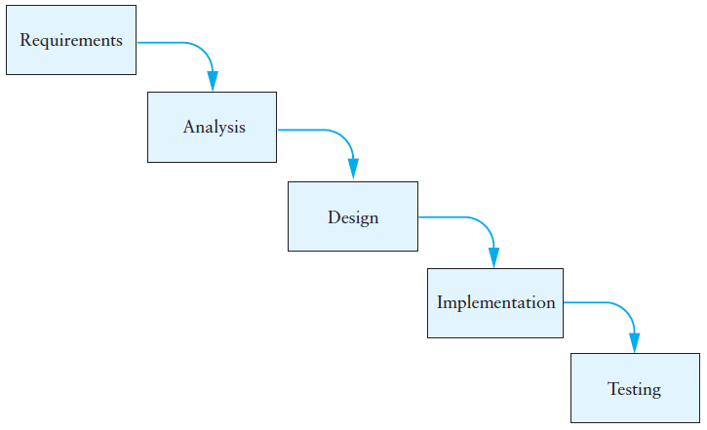
Software Life Cycle Models
The waterfall model is one of the simplest software life cycle models
In the waterfall model, activities are performed in sequence and the result of one flows into the next

Slide 16
Software Life Cycle Models (cont.)

Slide 17
Software Life Cycle Models (cont.)
While simple in concept, the waterfall method generally is unworkable in practice
The model requires each stage to be completed before the next stage is started
Rarely, in actual practice, does this occur
Misunderstandings of user specifications, incomplete design specifications, and/or incomplete implementations require reworking stages

Slide 18
Software Life Cycle Models (cont.)
The unified model attempts to resolve problems of the waterfall model
The unified model divides the problem into cycles (called phases or iterations) similar to mini-versions of the waterfall model
At the end of each cycle a review with the users takes place to obtain feedback which is taken into account in the next cycle

Slide 19
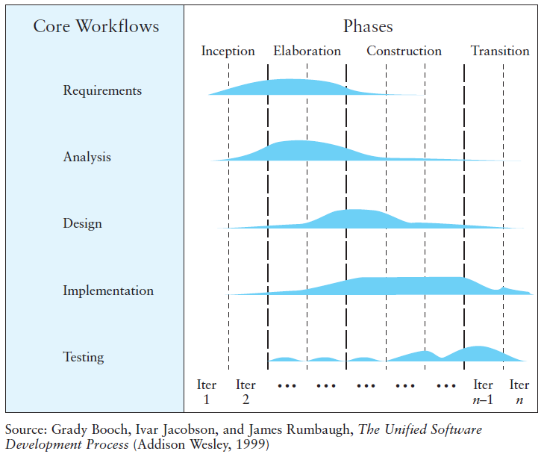
Software Life Cycle Models (cont.)

Slide 20
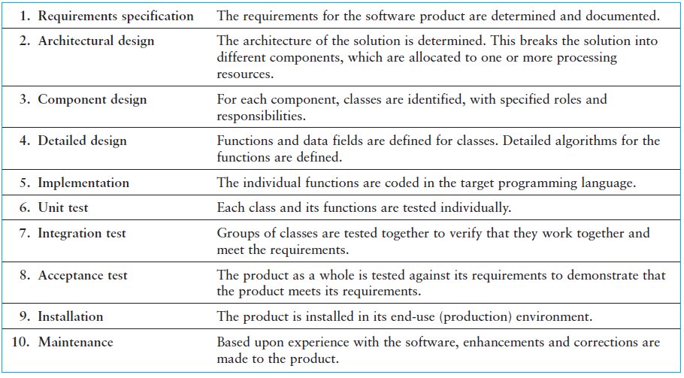
Software Life Cycle Activities
We will consider activities 1 through 5 in this chapter

Slide 21
Requirements Specifications
To clarify exactly what the users of the software want, it is imperative that a complete, written description of the requirements—a requirements specification—be generated as the project begins
A requirements specification requires extensive interaction between the user(s) and the system analyst(s)

Slide 22
Requirements Specifications (cont.)
Given the following problem, what questions come to mind that might require clarification?
Problem: Write an interactive telephone directory program that will contain a collection of names and telephone numbers. You should be able to insert new entries in the directory, retrieve an entry in the directory, or change a directory entry.

Slide 23
Requirements Specifications (cont.)
Is there an initial list of names and numbers to be stored in the directory beforehand, or are all entries inserted at run time?
If there is an initial list, is it stored in a file, or should it be entered interactively?
If the initial directory is stored in a file, is the file a text file or a binary file?
If the file is a text file, are there any formatting conventions? Are the name and number on the same line or on separate lines? How are the names stored?
Can more than one telephone number be associated with a particular name? If so, should the first number be retrieved, the last number, or all numbers?
Is it possible to change a person's name as well as the person's phone number?
When a number is retrieved, should both the person's name and number be displayed or just the number? What form should this display take?
What action should be taken if a "new" entry has the same name as a person already in the directory? Should this be flagged as an error?

Slide 24
Analysis
Before the analysis stage begins, you should achieve a complete understanding of the problem by developing an accurate requirements specification
During analysis, different approaches to the program design are considered and evaluated

Slide 25
Analysis (cont.)
Some considerations in the analysis stage:
Are commercial software packages available to satisfy some or all of the requirements or should the software be developed entirely in-house?
What new hardware or software may be needed to develop and run the new system?
What is the appropriateness of each option, considering estimated costs and benefits?
Develop good habits by taking a similar approach to your programming assignments

Slide 26
Analysis (cont.)
As a student completing programming assignments for this class, you have less flexibility
Requirements typically are fully specified for you
During the analysis stage in this course:
Carefully determine the input/output requirements of the system
Consider its interaction with the user
Break up your system into a set of small and manageable components (this process will be completed in the design phase)

Slide 27
Top-Down Design
Top-down design (also called stepwise refinement) starts at the top level (the original problem) and divides it into subproblems
For each subproblem, it identifies a subsystem for solving that subproblem

Slide 28
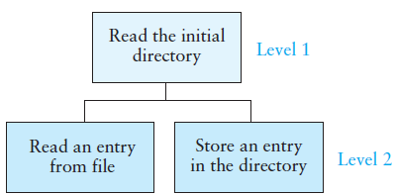
Top-Down Design (cont.)

Slide 29
Top-Down Design (cont.)

Slide 30
Object-Oriented Design
Unlike top-down design which focuses on actions, object-oriented design (OOD) focuses on data elements and operations together
In OOD, we
identify the objects that participate in our problem (whose common characteristics form a class) then
identify how the objects interact to form a solution (the interaction occurs through messages)
for each class, provide an operator (usually a function) to process the message
Usually looking at the nouns in the problem statement often helps us identify objects; verbs often indicate operators

Slide 31
Object-Oriented Design (cont.)
Looking at the phone directory problem, we see a need for:
a directory
entries in the directory
a name and number in the entry
a data file that contains entries
There is also a user, or actor who is external to the problem
The user selects operations performed on the directory and entries

Slide 32
Object-Oriented Design (cont.)
OOD incorporates some of the elements of top-down design, but
It also incorporates some of the elements of bottom-up design (which focuses on the design of individual system components)
OOD is a combination of both top-down and bottom-up design

Slide 33
UML as a Design Tool
We use Unified Modeling LanguageTM (UML) diagrams as a design tool to illustrate the interaction
between classes and
between classes and external entities (often users, but not always)
UML diagrams are a standard means of documenting class relationships, and are widely used in industry
You should use UML diagrams to describe the classes you develop for your programming assignments

Slide 34
UML as a Design Tool (cont.)

Slide 35
Using Abstraction to Manage Complexity
Section 1.2

Slide 36
Abstraction
Abstraction is a powerful technique that helps programmers (or problem solvers) deal with complex issues in a piecemeal fashion
An abstraction is a simplified model of a physical entity or activity

Slide 37
Abstraction (cont.)
Abstraction example
A program variable (such as name or number) denotes a storage location in memory for the data value
We do not need to be concerned with the details of the physical structure of memory or the actual bits (binary digits) used to represent the value of the variable

Slide 38
Abstraction (cont.)
Abstraction example
To drive a car, we need to know how to
use a key to start the engine
use the accelerator and brake pedals to control speed
use the steering wheel to control direction
However, we don't need to know details of the car's electrical system, drive train, braking system, or steering mechanism

Slide 39
Procedural Abstraction
Procedural Abstraction is the concept that procedural development should separate the concern of what is to be achieved by a procedure from the details of how it is achieved
In other words,
we can specify what we expect a function to do
then use that specification in the design of a problem solution before we decide how to implement the function

Slide 40
Procedural Abstraction (cont.)
If we have functions available to perform all the Level 2 steps here:

Slide 41
Procedural Abstraction (cont.)
we can write the following C++ fragment to retrieve an entry from the directory using these functions:

Slide 42
Data Abstraction
Data abstraction specifies
the data objects for a problem and
the operations to be performed on these data objects
without being overly concerned with how the data objects will be represented and stored in memory
This is the logical view of the data object as opposed to the physical view (its actual internal representation in memory)

Slide 43
Data Abstraction (cont.)
Once we understand the logical view, we can use the data object and its operators in our programs
However, we (or someone else) eventually will have to implement the data object and its operators before we can run any program that uses them
In C++, the operators are called member functions
We will use the term operators and member functions interchangeably

Slide 44
Data Abstraction (cont.)
The C++ string illustrates a data abstraction
We can use string objects and operators (length, at, and so on) without
knowing the details of their implementation
or how the sequence of characters is stored in memory

Slide 45
Information Hiding
Procedural abstraction and data abstraction enable the designer to make implementation decisions in a piecemeal fashion
The designer can postpone making decisions regarding the actual internal representation of the data objects and the implementation of its operators
The overall complexity can be controlled by separating top-level design from lower-level implementation

Slide 46
Information Hiding (cont.)
If the details of a data object's implementation are hidden from the higher-level module (a C++ class), the higher-level class can access the data object only through its member functions
This is an advantage because it allows internal changes to a function without having to rewrite the higher-level class
This process of "hiding" the details of a class's implementation is called information hiding

Slide 47
Information Hiding (cont.)
For the phone directory, if we assume my_entry is an object with a public field called name we could use the qualified identifier my_entry.name
But, if we change our mind and decide to use an array to hold both the name and number we would have to change all references of my_entry.name to my_entry.name[0]
Instead, we hide information by using a function to return the string name:
a_name = my_entry.get_name();

Slide 48
Defining C++ Classes
Section 1.3

Slide 49
Defining C++ Classes
A class can be thought of as a template for specifying or creating objects
A class represents a type
A type determines
what set of values an item of data can have and
the operations that can be performed on it
In C++, there are two kinds of types:
primitive or built-in types
user-defined or class types

Slide 50
Defining C++ Classes (cont.)
To define a class completely, we must provide two things:
a class definition
The class definition describes the class to its users—the names of the operations and the internal data contents (the data members)
a class implementation
The class implementation provides the implementations of the operations (the member functions)

Slide 51
Class Definition
A class consists of members
Data members
also called data fields or attributes
sometimes called instance variables because each class instance (object) has its own storage for them
may be either primitive types or class types
are private to hide implementation details
Member functions
also called operators, functions, or methods
are public to be visible to users

Slide 52
Class Definition Example
The class Clock describe a group of objects, each of which represents a time using a 12-hour clock
Operations that we want to perform on Clock objects are setting the time, determining the values of hours, minutes, and seconds, and advancing the clock by one second

Slide 53
Class Definition Example (cont.)
The class definition for Clock in a header file, Clock.h
The header file consists of only the member function declarations (the name and parameters)
The definition for class Clock is enclosed in braces ({ }) and there is a semicolon after the braces
The comments above each function declaration are introduced by /** rather than simply /* (We will discuss this at the end of the section)
#ifndef CLOCK_H_
#define CLOCK_H_
/** The class Clock represents the time of day */
class Clock {
public:
/** Set the clock */
void set_clock(int hr, int min, int sec);
/** Get the current hour */
int get_hours() const;
/** Get the current minute */
int get_minutes() const;
/** Get the current second */
int get_seconds() const;
/** Advance the clock by one second */
void tick();
private:
// implementation details defined here
};
#endif

Slide 54
Class Definition Example (cont.)
Preprocessor directives (#ifndef, #define, #endif) prevent multiple definitions of the identifiers in the header file
(The header may be included in two different files that are both included by a third file)
#ifndef CLOCK_H_
#define CLOCK_H_
/** The class Clock represents the time of day */
class Clock {
public:
/** Set the clock */
void set_clock(int hr, int min, int sec);
/** Get the current hour */
int get_hours() const;
/** Get the current minute */
int get_minutes() const;
/** Get the current second */
int get_seconds() const;
/** Advance the clock by one second */
void tick();
private:
// implementation details defined here
};
#endif

Slide 55
Class Definition Example (cont.)
Any preprocessor directive identifier may be used
However, common convention is to use the file name in uppercase replacing the period with an underscore and appending a trailing underscore
#ifndef CLOCK_H_
#define CLOCK_H_
/** The class Clock represents the time of day */
class Clock {
public:
/** Set the clock */
void set_clock(int hr, int min, int sec);
/** Get the current hour */
int get_hours() const;
/** Get the current minute */
int get_minutes() const;
/** Get the current second */
int get_seconds() const;
/** Advance the clock by one second */
void tick();
private:
// implementation details defined here
};
#endif
Clock.h
CLOCK_H_

Slide 56
The public and private Parts
The keywords public and private are known as access specifiers
Members declared in the public part of the class definition can be accessed by any other class
Members declared in the private part can be accessed directly only within class Clock

Slide 57
The public and private Parts (cont.)
Information hiding does not mean that the client programmer (the programmer who uses the class) cannot see the information in the private declarations
The client programmer can view the private declarations
However, this information is not directly accessible in the client program

Slide 58
The public and private Parts (cont.)
We have two choices for storing the time in our class:
Provide separate data fields for hours, minutes, and seconds
Provide a single data field that contains the number of seconds since midnight
We choose the first, which simplifies implementation of all member functions except for tick()

Slide 59
The public and private Parts (cont.)
After the keyword private in our header we insert the following:
/** The hours since midnight or noon */
int hours;
/** The minutes within the current hour */
int minutes;
/** The seconds within the current minute */
int seconds;

Slide 60
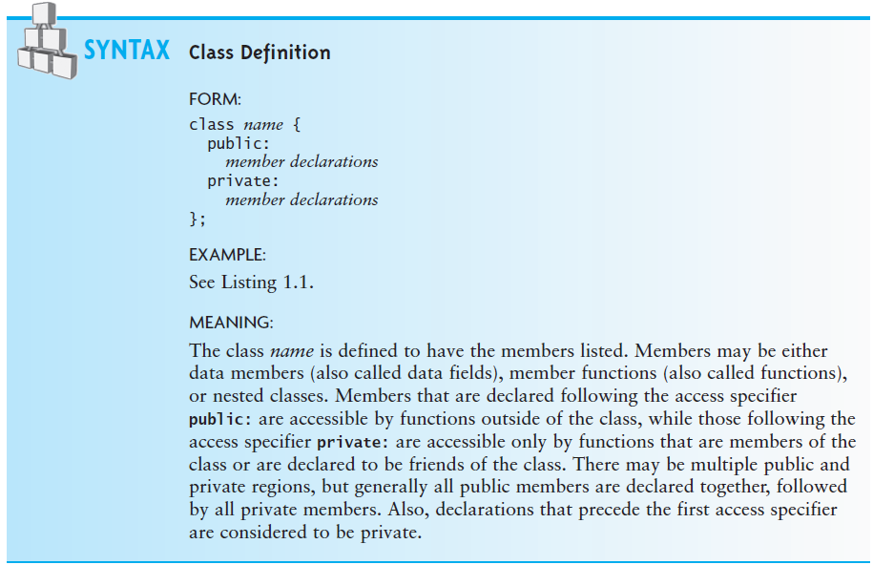
The public and private Parts (cont.)

Slide 61
Private Data Fields, Public Functions
Whatever is declared after the private access specifier can be accessed only within the class definition
The data fields can be accessed only by invoking one of the public member functions that is part of the class
The reasons for this are
to control access to an object's data
to prevent improper use and processing of an object's data
to allow the implementer to change how the private data is represented without other programs that use the class needing to make changes

Slide 62
Constant Member Functions
The declarations for the functions get_hours, get_minutes, and get_seconds each have the keyword const immediately preceding the semicolon
This tells the users and the complier that these functions will not modify the object on which they operate
#ifndef CLOCK_H_
#define CLOCK_H_
/** The class Clock represents the time of day */
class Clock {
public:
/** Set the clock */
void set_clock(int hr, int min, int sec);
/** Get the current hour */
int get_hours() const;
/** Get the current minute */
int get_minutes() const;
/** Get the current second */
int get_seconds() const;
/** Advance the clock by one second */
void tick();
private:
// implementation details defined here
};
#endif

Slide 63
Constant Member Functions (cont.)
This serves three purposes:
It documents for the user that calling this function will not change its value
It permits the compiler to incorporate certain optimizations when it generates the machine language code
It allows the compiler to flag as an error any operation that could potentially modify the object
#ifndef CLOCK_H_
#define CLOCK_H_
/** The class Clock represents the time of day */
class Clock {
public:
/** Set the clock */
void set_clock(int hr, int min, int sec);
/** Get the current hour */
int get_hours() const;
/** Get the current minute */
int get_minutes() const;
/** Get the current second */
int get_seconds() const;
/** Advance the clock by one second */
void tick();
private:
// implementation details defined here
};
#endif

Slide 64
Class Implementation
Member function definitions are the same as regular function definitions except that the class name is placed in front of the function name, separated from the name by a pair of colons
int Clock::get_hours() const {
return hours;
}

Slide 65
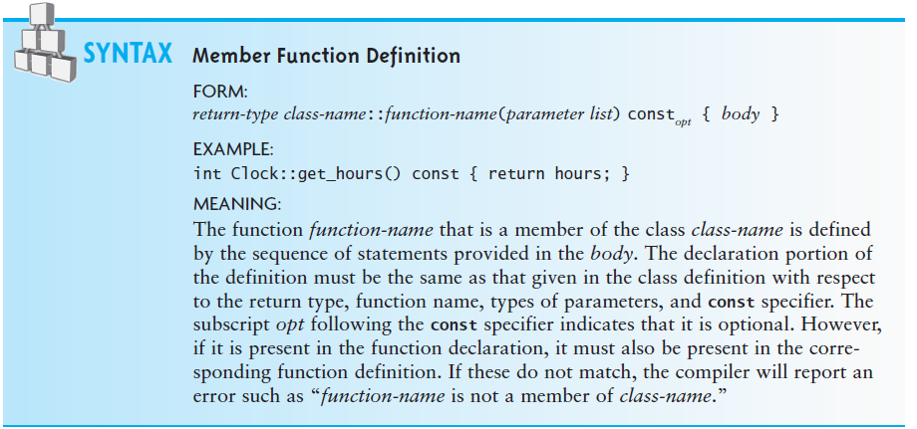
Class Implementation (cont.)

Slide 66
Class Implementation (cont.)
Usually all of the member function definitions of a class are grouped into a single source (.cpp) file
The source file must begin with a line that includes the header file
Our Clock.cpp file should begin with the line
#include "Clock.h"
The header file name is surrounded by quotes, not angle brackets (<>)
Angle brackets are used only for system-defined classes

Slide 67
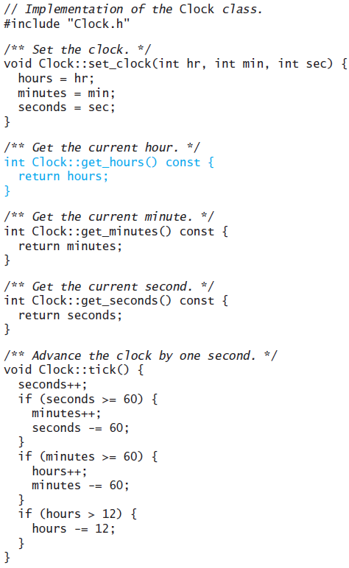
Class Implementation (cont.)

Slide 68
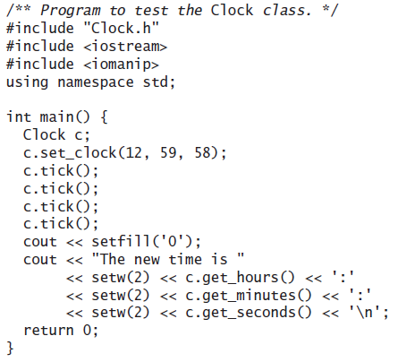
Using Class Clock
The time is displayed as 01:00:02

Slide 69
The Class Person
A Person object might store the following data:
given name
family name
ID number
year of birth

Slide 70
The Class Person (cont.)
The following operations could be performed on a Person object:
Calculate the person's age
Test whether two Person objects refer to the same person
Determine whether the person is old enough to vote
Determine whether the person is a senior citizen
Get one or more of the data fields for the Person object
Set one or more of the data fields for the Person object

Slide 71
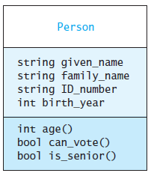
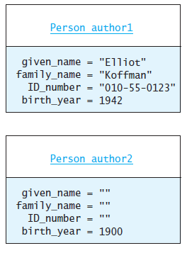
The Class Person (cont.)
UML (Unified Modeling Language) diagrams

Slide 72
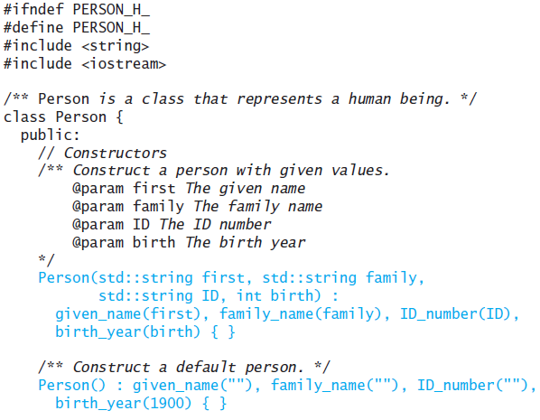
The Class Person

Slide 73
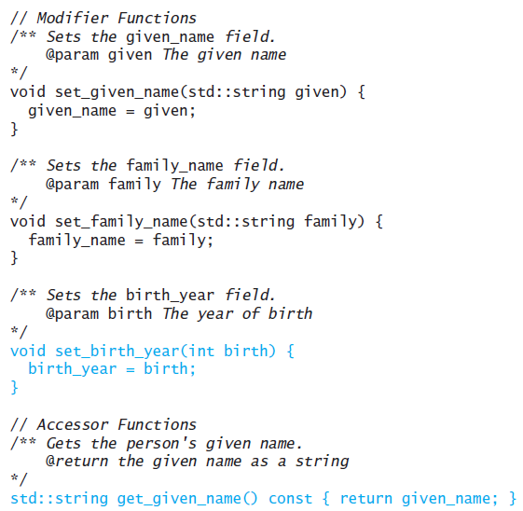
The Class Person (cont.)

Slide 74
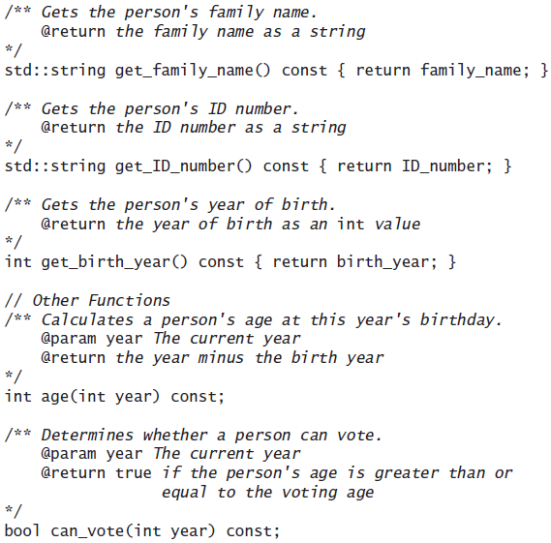
The Class Person (cont.)

Slide 75
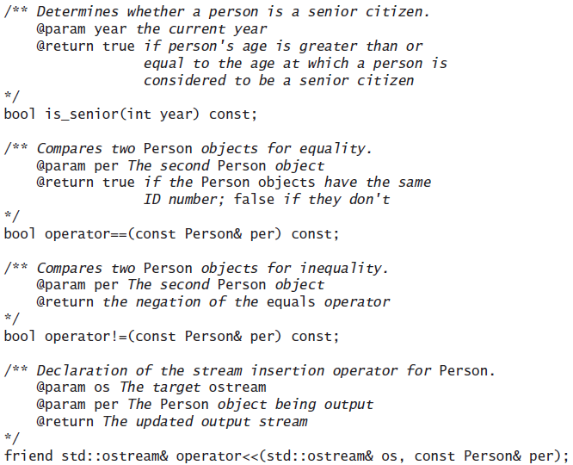
The Class Person (cont.)

Slide 76
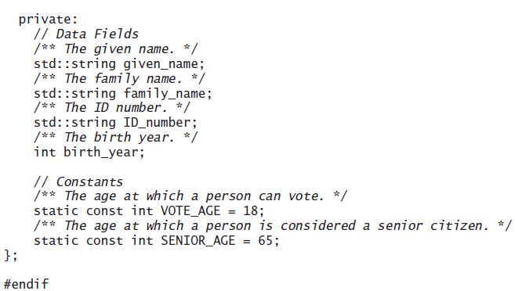
The Class Person (cont.)

Slide 77
The Class Person (cont.)
Notes on the previous listing:
The data fields and constants are declared after the functions (some C++ programmers prefer to reverse this order)
The modifier const indicates that the constant value may not be changed
The modifier static indicates that the constant is being defined for the class and is not replicated in each instance
Several of the member functions are not only declared but also implemented in the header file (the reason for this is discussed next)

Slide 78
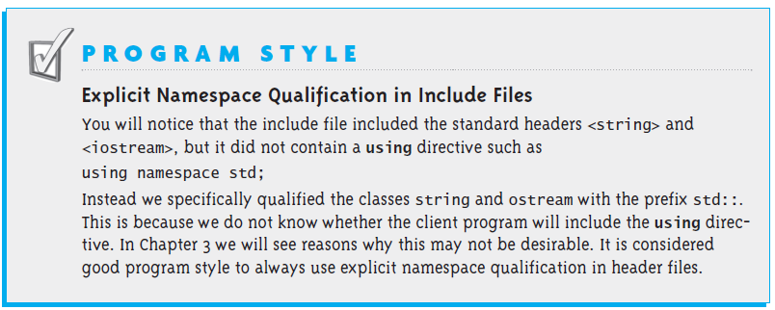
The Class Person (cont.)

Slide 79
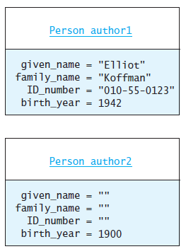
Constructors
Two constructors are listed in the previous code
Exactly one constructor is invoked (automatically) when a new class instance is created
If all data fields are supplied, the statement
Person author1("Elliot", "Koffman", "010-55-0123", 1942);
creates the first object, initializing all the data fields

Slide 80
Constructors (cont.)
The second constructor, the no-parameter constructor, is called when the data field values are not known at the time the objected is created
The statement
Person author2;
creates the second object
The declaration of a constructor differs from a member function in that it has no return type

Slide 81
Constructors (cont.)
You can use modifier functions at a later time to set or modify the values of the data fields

Slide 82
Constructors (cont.)
The no-parameter constructor is sometimes called the default constructor because C++ automatically defines this constructor for a class that has no constructor definitions
/** Default constructor for class Clock. */
Clock::clock() {}
However, if we define one or more constructors for a class, we must also explicitly define the no-parameter constructor or it will be undefined for that class

Slide 83
Constructors (cont.)

Slide 84
Modifer and Accessor Member Functions
Because data fields have private visibility, we need to provide public member functions to access them
To retrieve the value of a data field we create an accessor member function (also called a getter)
An accessor should begin with the word get and ends with the name of the data field (for example, get_family_name)

Slide 85
Modifer and Accessor Member Functions (cont.)
To allow a class user to update or modify the value of a field, we provide a modifer member function (also called a setter or mutator)
A modifer should begin with the word set and ends with the name of the data field (for example, set_given_name)

Slide 86
Modifer and Accessor Member Functions (cont.)
In our Person example, each data field has an accessor
All data fields have a modifier except for ID_number
It may not be appropriate to allow a user program to modify a person's ID number
It might be desirable to have get_ID_number return only a portion of the value stored in data field ID_number (for example, the last few digits)

Slide 87
Modifer and Accessor Member Functions (cont.)
Modifier member functions are of type void because they are executed for their effect (to update a data field) rather than to return a value
void set_birth_year(int birth) {
birth_year = birth;
}

Slide 88
Modifer and Accessor Member Functions (cont.)
The accessor function for the data field given_name
std::string get_given_name() const {
return given_name;
}
is type std::string because it returns a copy of the string object given_name
The const in the function declaration indicates that this function does not change the value of the object on which it is called

Slide 89
Operators
In addition to functions in class Person, we declare the operators == and !=
bool operator==(const Person& per) const;
bool operator!=(const Person& per) const;
Now we can write Boolean expressions as we do with primitive types to compare Person objects:
author1 == author2
author1 != author2
In C++ this is called overloading operators

Slide 90
Operators (cont.)
The insertion operator ( << ) used to output data to an ostream such as cout is an overloading of the left shift operator
The class ostream contains several overloaded member functions named operator<< that take primitive types as parameters
To output a class type, we must define this operator for that class

Slide 91
Friends
To define this operator, we must declare a stand-alone function in the class definition. For class Person it would be:
friend std::ostream& operator<<(std::ostream&, const Person&);
The first parameter is the left-hand operand and the second is the right-hand operand:
cout << author1;
It returns a reference to the output stream that has been modified
Because it is a stand-alone function, it is not a member of either class ostream or class Person
We declare the function friend in the .h file, giving it the same rights as member functions, allowing it to access the private members of the class

Slide 92
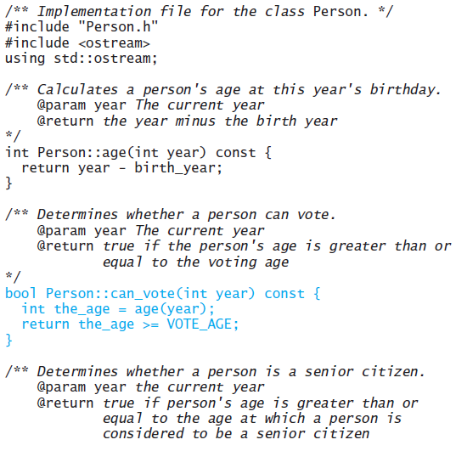
Implementing the Person Class

Slide 93
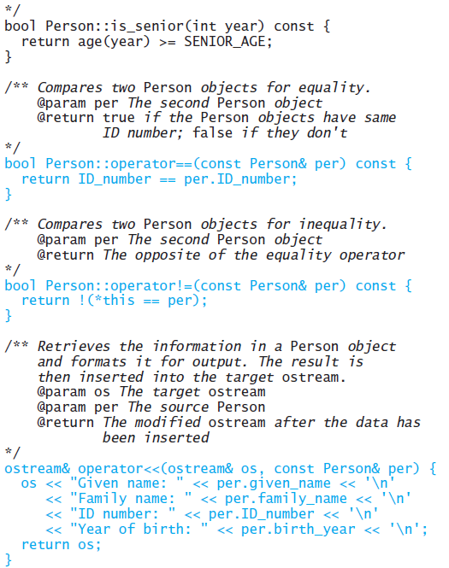
Implementing the Person Class (cont.)

Slide 94
Declaring Local Variables in Class Person
bool Person::can_vote(int year) const {
int the_age = age(year);
return the_age >= VOTE_AGE;
}
The variable the_age is a local variable
Its scope is inside the body of the function only
The function also can be rewritten without a local variable:
bool Person::can_vote(int year) const {
return age(year) >= VOTE_AGE;
}

Slide 95
Implementing the Operators
If we assume two Persons are the same if they have the same ID number, we can define the == operator:
bool Person::operator==(const Person& per) const {
return ID_number == per.ID_number;
}
Because ID_number is a string, the string operator == is invoked
To implement operator!=, we return the opposite of what operator== returns:
bool Person::operator!=(const Person& per) const {
return !(*this == per);
}

Slide 96
The this Parameter
Each member function has an implicit parameter named this whose value is a pointer to the object with which the member function was called
Normally, we do not need to use the this parameter because references to members are implicitly understood to be the object for which the member function was called
For operator!= we wanted to apply the == operator between the object with which the function was called and the other object, per
bool Person::operator!=(const Person& per) const {
return !(*this == per);
}

Slide 97
The this Parameter (cont.)
bool Person::operator!=(const Person& per) const {
return !(*this == per);
}
We could also have written the function above as:
bool Person::operator!=(const Person& per) const {
return !(operator==(per));
}

Slide 98
Defining the Extraction Operator
ostream& operator<<(ostream& os, const Person& per) {
os << "Given name: " << per.given_name << '\n'
<< "Family name: " << per.family_name << '\n'
<< "ID number: " << per.ID_number << '\n'
<< "Year of birth: " << per.birth_year << '\n';
return os;
}
Using author1 from our previous example, calling
cout << author1;
displays
Given name: Elliot
Family name: Koffman
ID Number: 010-55-0123
Year of Birth: 1942

Slide 99
An Application That Uses Class Person
To test class Person we need to write a C++ application program that consists of a main function
The main function should create one or more instances of class Person and display the results of applying the class functions
A main function that is written primarily to test another class is often called a driver program
A test that demonstrates that certain requirements of a particular class are met is called a unit test

Slide 100
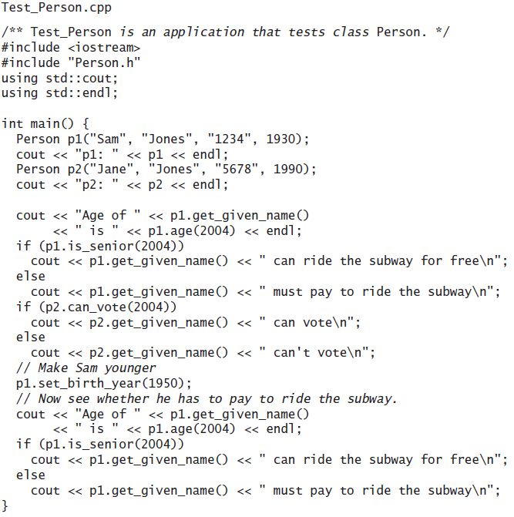
An Application That Uses Class Person (cont.)

Slide 101
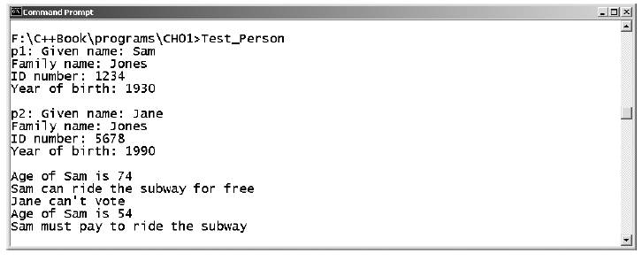
An Application That Uses Class Person (cont.)

Slide 102
Classes as Components of Other Classes
Class Person has three data fields of type string
This component relationship is represent by the solid diamonds in the following UML diagram

Slide 103
Array Data Fields
An array and the functions that process it are commonly encapsulated within a class
If we want the client to specify the array size when an object is created, we need to define a constructor with the array size as a parameter
The constructor then allocates storage for the new array

Slide 104
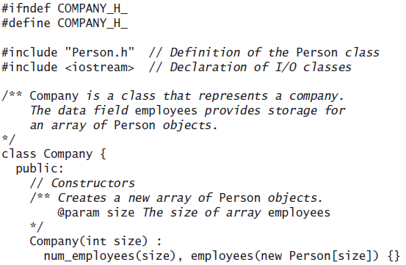
Array Data Fields (cont.)

Slide 105
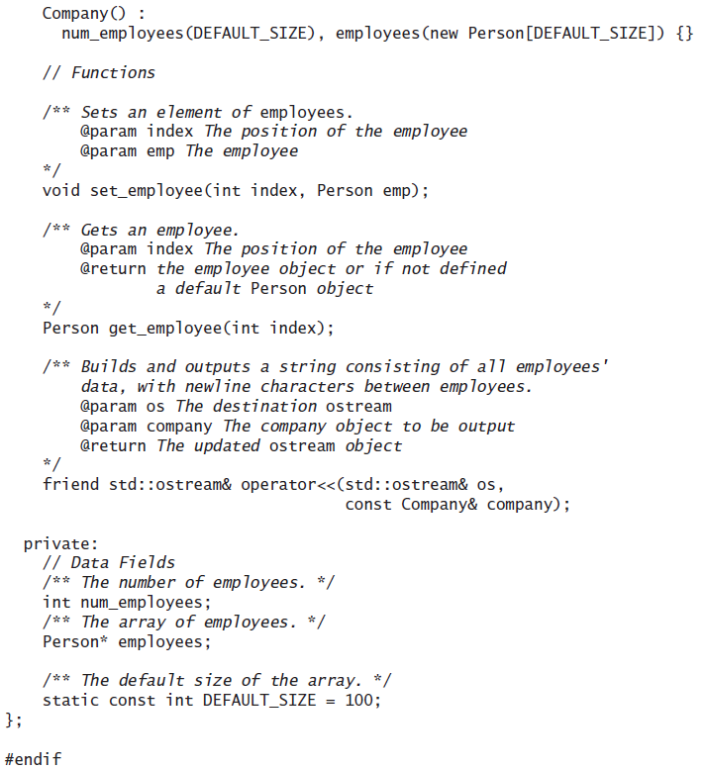
Array Data Fields (cont.)

Slide 106
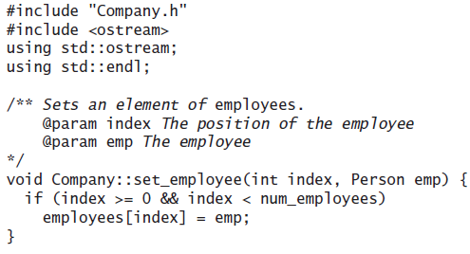
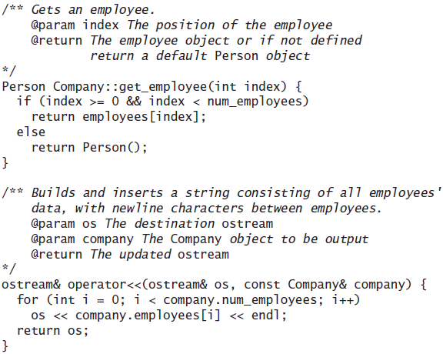
Company.cpp

Slide 107
Array Data Fields
The following main function illustrates the use of class Company and displays the state of object comp
#include "Company.h"
#include <iostream>
using std::cout;
int main() {
Company comp(2);
comp.set_employee(0, Person("Elliot", "K", "123", 1942));
comp.set_employee(1, Person("Paul", "W", "234", 1945));
cout << comp;
return 0;
}

Slide 108
Documentation Styles for Classes and Functions
We write documentation comments for classes, member functions, and data members in a standard format that originally was developed for the Java language
The Java SDK contains a program called Javadoc that reads a Java program file and writes neatly formatted HTML documentation pages if the program contains the documentation comments in the standard form
The format has gained popularity for documenting programs in other languages
Two freely available programs that run on C++ code are DOC++ and Doxygen

Slide 109
Documentation Styles for Classes and Functions (cont.)
These programs look for text enclosed within the delimiters /** and */
Lines within these delimiters that begin with the symbol @ are tags
Use one @param tag for each function parameter
Do not use a @return tag for void functions
The first line of the delimitated comment appears in the function summary part of the HTML page
(the image on the following slide was produced by running Doxygen for class Person)

Slide 110
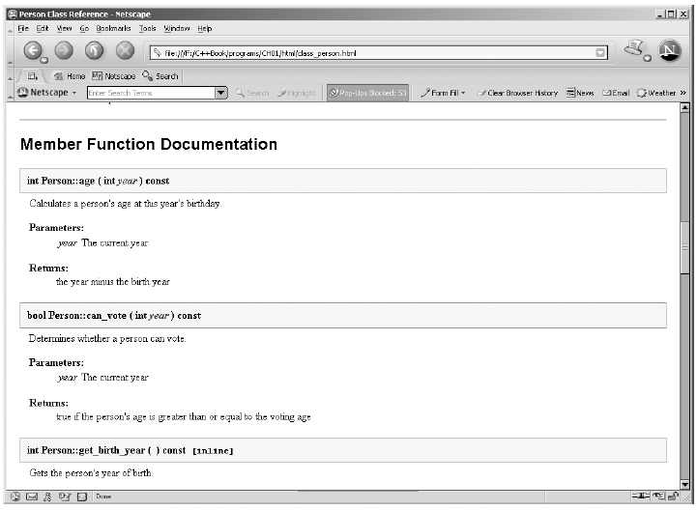
Documentation Styles for Classes and Functions (cont.)

Slide 111
Abstract Data Types, Interfaces, and Pre- and Postconditions
Section 1.4

Slide 112
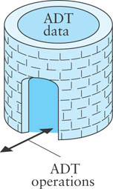
ADTs
Abstract Data Type (ADT)
An encapsulation of data and methods
Allows for reusable code
The user need not know about the implementation of the ADT
A user interacts with the ADT using only public methods

Slide 113
ADTs (cont.)
A class provides one way to implement an ADT in C++
Public functions control access to private data fields and determine the manner in which the data is manipulated
A primary goal of this course is to learn how to write and use ADTs in programming
Creating our own library of ADT implementations (classes) that have been coded, debugged, and tested makes it easier to design and implement new application programs
The C++ Standard Library provides a rich collection ADT implementations

Slide 114
ADTs and Interfaces
The public part of a class definition specifies (but does not implement) an ADT
It specifies the
names
parameters
return values
of the ADT operations without specifying how the operations are performed or how the data is represented internally
The public part of a class definition defines the interface for the class

Slide 115
ADTs and Interfaces (cont.)
An ADT describes a set of classes that perform the operations and define the internal data
Classes that declare the data fields and code member functions that perform the operations implement the ADT
ADTs often can be implemented in more than one way
Hence, more than one class can implement an ADT
Each class that implements an ADT must provide the complete definition (implementation) of all operations declared in the ADT

Slide 116
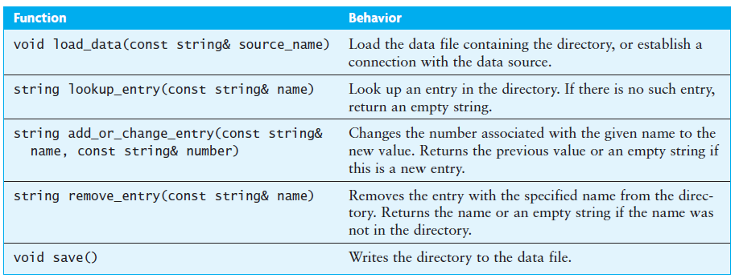
An ADT for a Telephone Directory Class
We define an ADT that specifies the operations required of all classes that may implement the ADT

Slide 117
Contracts and ADTs
An ADT is a contract between the ADT designer and the programmer who codes the class the implements it
Any programmer who uses a class that implements an ADT will know exactly what functions are available in that class and what operations they will perform
Programmers who use the class do not need to coordinate with the programmer implementing the class

Slide 118
Preconditions and Postconditions
Pre- and postconditions are part of the contract between a function called and the function programmer
A precondition is a statement of any assumptions or constraints on the operation's data (input parameters) that are expected to apply before the operation is performed
If a precondition is not met, there is no guarantee that the function will do what is expected
A postcondition is a statement that describes the result of performing an operation
When implementing an ADT, we document the preconditions and postconditions in the documentation comments

Slide 119
Preconditions and Postconditions (cont.)
We will use pre- and postconditions only when they provide additional information that is not readily apparent
As a general rule, we will write a postcondition comment for operations with a void return type that change an object's state
If an operation returns a value, usually you can describe the postcondition in the @return tag

Slide 120
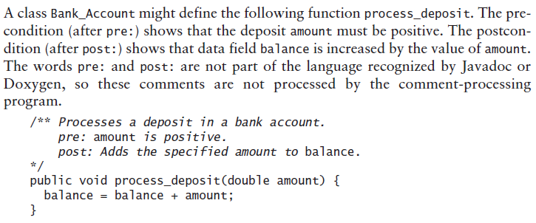
Preconditions and Postconditions (cont.)

Slide 121
Requirements Analysis, Use Cases, and Sequence Diagrams
Section 1.5

Slide 122
Case Study: Designing a Telephone Directory Program
A client wants to store a simple telephone directory in her computer that she can use for storage and retrieval of names and numbers. She has a data file that contains the names and numbers of her friends. She wants to insert new names and numbers, change the number for an entry, and retrieve selected telephone numbers. She also wants to save any changes in her data file.
Problem

Slide 123
Case Study: Designing a Telephone Directory Program (cont.)
INPUTS
Initial phone directory
Each name and number will be read from separate lines of a text file. The entries will be read in sequence until all entries are read
OUTPUTS
Additional entries
Each entry is typed by the user at the keyboard when requested
Names and phone numbers
The name and number of each person selected by the program user are displayed on separate output lines
Updated phone directory
Each name and number will be written to separate lines of a text file. The entries will be written in sequence until all entries are written

Slide 124
Case Study: Designing a Telephone Directory Program - Analysis
Use Cases
A use case is a list of the user actions and system response for a particular subproblem in the order that they are likely to occur
Subproblems for the telephone directory program:
Read the initial directory from an existing file
Insert a new entry
Edit an existing entry
Retrieve and display an entry

Slide 125
Case Study: Designing a Telephone Directory Program - Analysis (cont.)

Slide 126
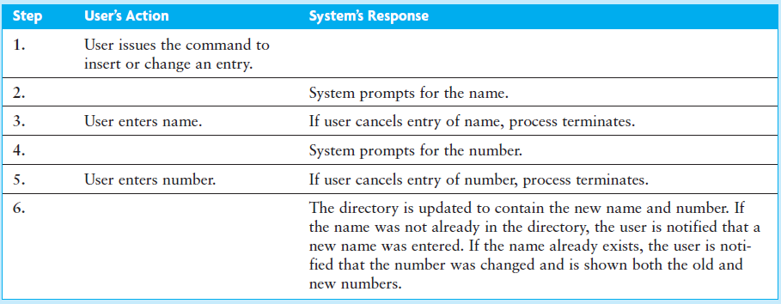
Case Study: Designing a Telephone Directory Program - Analysis (cont.)

Slide 127
Case Study: Designing a Telephone Directory Program - Analysis (cont.)

Slide 128
Case Study: Designing a Telephone Directory Program – Analysis (cont.)
Refinement of Initial Class Design
We combined the second and third subproblems ("Insert a new entry", "Edit an existing entry") and added a subproblem to save the directory:
Read the initial directory from an existing file
Insert a new entry or edit an existing entry
Retrieve and display an entry
Save the modified directory back to the file
The directory should be saved whenever the program is exited

Slide 129
Case Study: Designing a Telephone Directory Program – Analysis (cont.)
We can split this problem into subproblems in another way...
We want a phone directory application that combines
a user interface as the front end and
a persistent (permanent) storage of data as the back end

Slide 130
Case Study: Designing a Telephone Directory Program - Analysis (cont.)
The black diamond in the figure below indicates that a PD_Application object has an object of type Phone_Directory as its component and that it is created by the PD_Application object
The arrowhead shows that PD_Application updates the Phone_Directory object

Slide 131
Case Study: Designing a Telephone Directory Program - Analysis (cont.)
Phone_Directory is the abstract data type—it is shown in the class diagram as an interface (in UML an interface is equivalent to an ADT)
We can split our design between the user interface (PD_Application) and the directory so that we can work on them independently

Slide 132
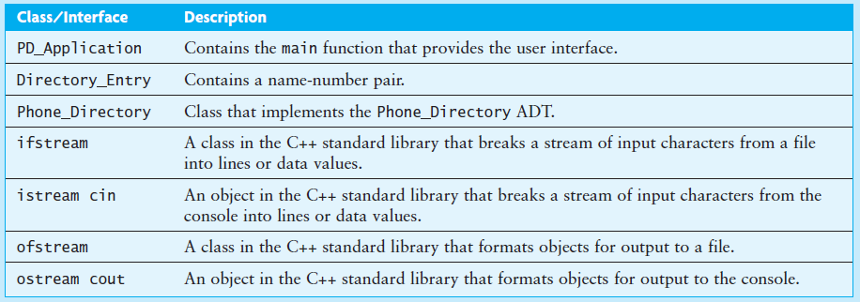
Case Study: Designing a Telephone Directory Program - Design
Next we identify all the classes needed and describe their interaction

Slide 133
Case Study: Designing a Telephone Directory Program – Design (cont.)
Algorithm for main function
Send the Phone_Directory a message to read the initial directory data from a file
Read a command from the user
do
Prompt the user for a command
Read the command
Send the appropriate message to the Phone_Directory to execute the command
Report the result to the user
while the command is not exit

Slide 134
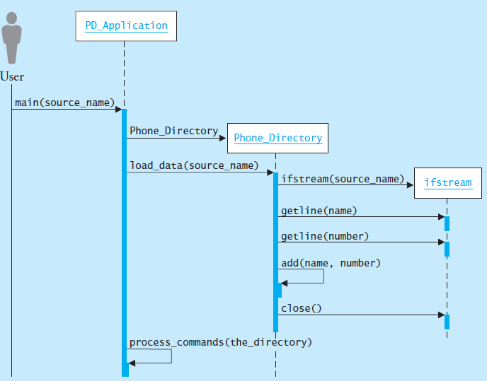
Case Study: Designing a Telephone Directory Program – Sequence Diagram

Slide 135
Design of an Array-Based Phone Directory
Section 1.6

Slide 136
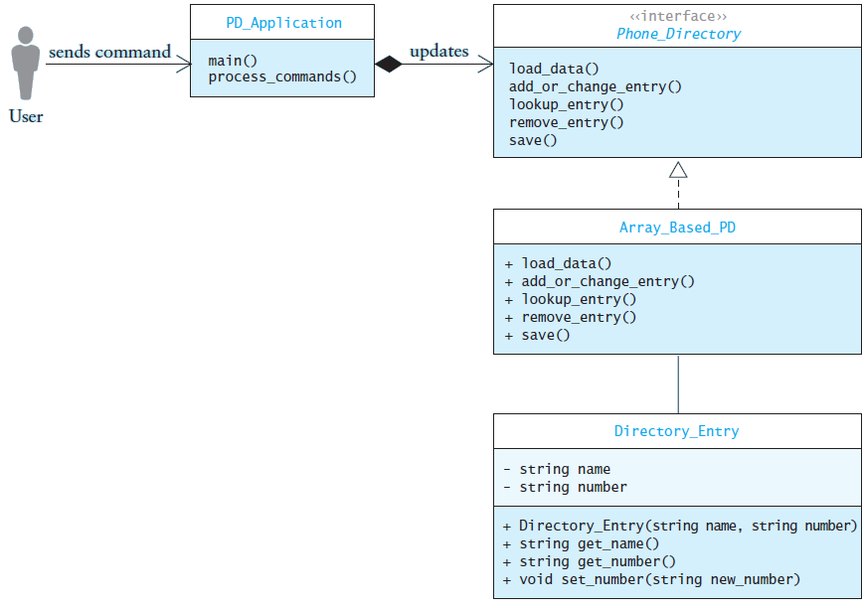
Design of Data Structures for the Phone Directory
Now we consider the actual data elements

Slide 137
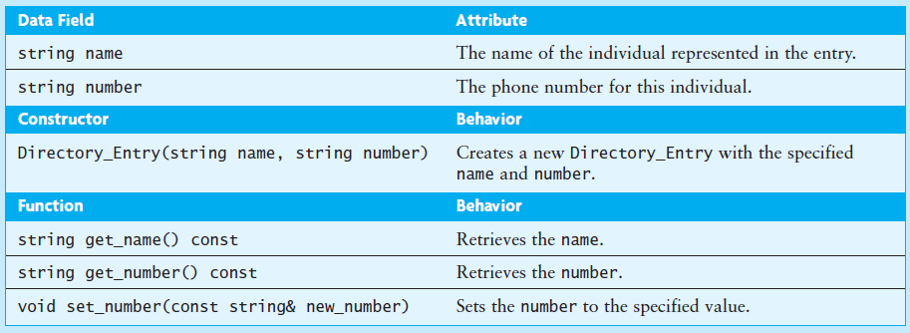
Design of the Directory_Entry Class

Slide 138
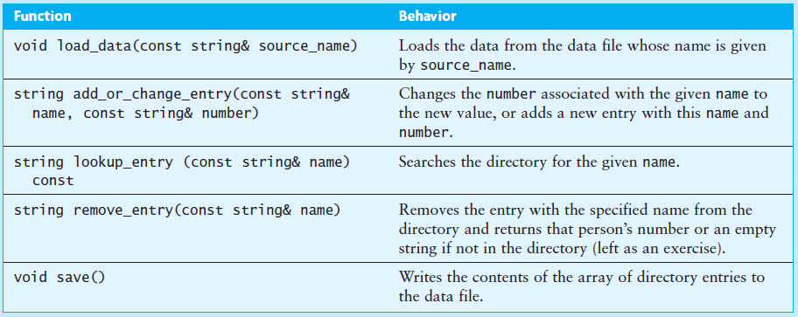
Design of the Directory_Entry Class (cont.)

Slide 139
Design of the Array_Based_PD Class
Indirection: the_directory contains the address of a Directory_Entry object

Slide 140
Design of the Array_Based_PD Member Functions
Algorithm for Function load_data
Create an ifstream for the input file
Read the name of the data file
while the ifstream is not in the fail state
Read the number
if the ifstream is not in the fail state
Add a new entry using function add
Read the name

Slide 141
Design of the Array_Based_PD Member Functions (cont.)
Algorithm for Function add_or_change_entry
Call function find to see if the name is in the directory
if the name is in the directory
Change the number using the set_number function of the Directory_Entry
Return the previous value of the number
else
Add a new entry using function add
Return an empty string

Slide 142
Design of the Array_Based_PD Member Functions (cont.)
Algorithm for Function lookup_entry
Call function find to see if the name is in the directory
if the entry is found
Directory_Entry's get_number function retrieves the number, which is returned to the caller
else
The empty string is returned

Slide 143
Design of the Array_Based_PD Member Functions (cont.)
Algorithm for Function save
Create an ofstream object associated with the file
for each entry in the array
Call get_name to get the name from the entry
Write the name on a line
Call get_number to get the number from the entry
Write the number on a line
Close the ofstream

Slide 144
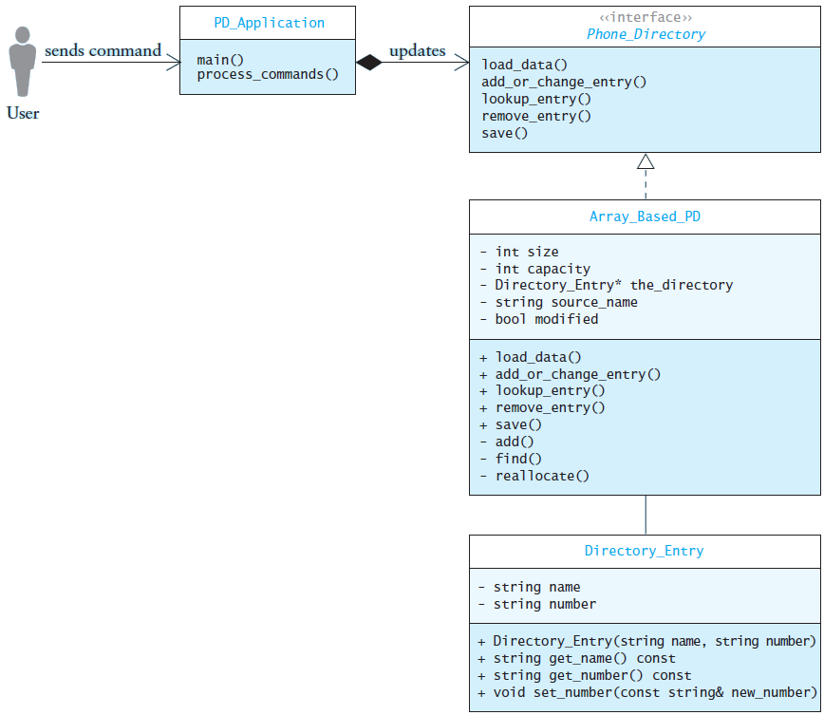
Design of the Array_Based_PD Member Functions (cont.)

Slide 145
Implementing and Testing the Array-Based Phone Directory
Section 1.7

Slide 146
Implementation

Slide 147
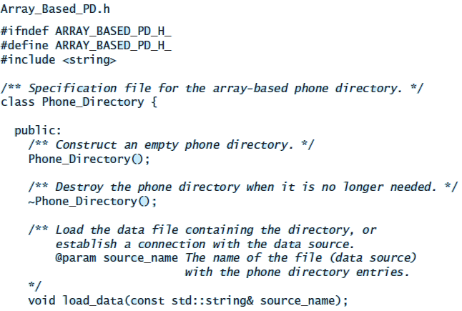
Implementation (cont.)

Slide 148
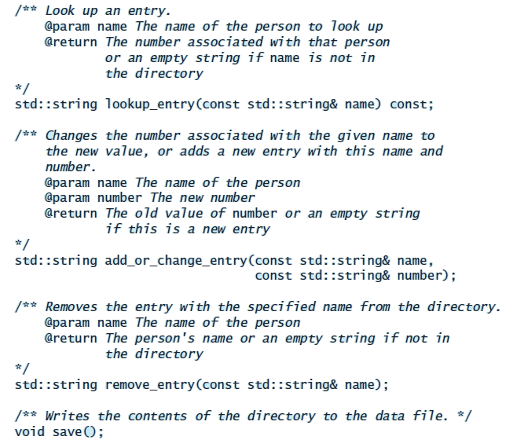
Implementation (cont.)

Slide 149
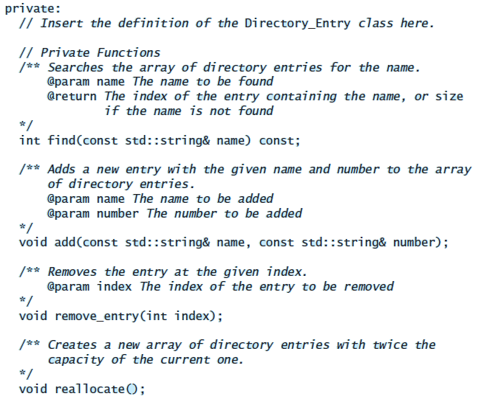
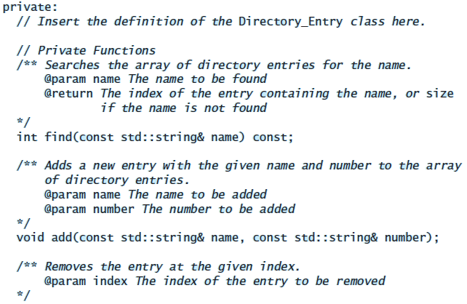
Implementation (cont.)

Slide 150
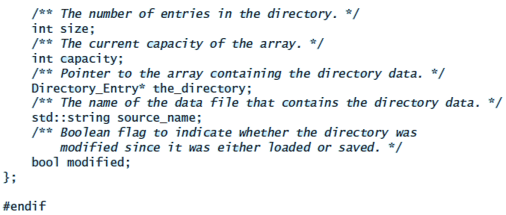
Implementation (cont.)

Slide 151
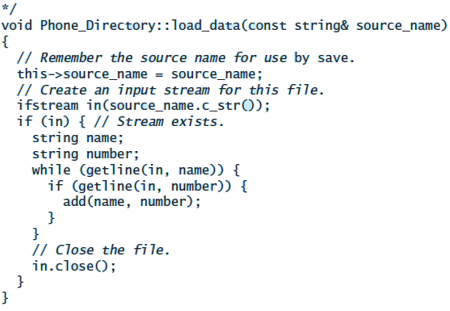
Coding the Functions in the Implementation File

Slide 152
Testing
To test this class, you should
run it with data files that are empty
run it with data files that contain a single name-and-number pair
run it with data files that contain an odd number of lines (ending with a name but no number)
run it with a completely filled array and try to add a new entry (does function reallocate double the array's size?)
try retrieving names not in the directory and names in the directory
verify that if an entry is changed, the new number is retrieved
check that all new and edited entries are written correctly to the output file

Slide 153
Completing the Phone Directory Application
Section 1.8

Slide 154
Analysis
The function process_commands should present a menu of choices to the user:
Add or Change an Entry
Look Up an Entry
Remove an Entry
Save the Directory Data
Exit the Program

Slide 155
Design
The function process_commands will use a "menu-driven" loop to control the action with the user

Slide 156
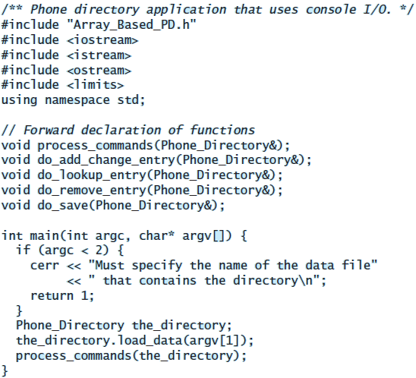
Implementation: PD_Application.cpp

Slide 157
Implementation: PD_Application.cpp

Slide 158
Implementation: PD_Application.cpp

